Slide 1
2. Approche méthodologique en CGE

Slide 2
Different approaches
Agronomic et ecological models
Economic models
Sound physical ground
Focused on production side
Detailed resolution level
Suitable for potential of production assessment, environmental impacts, carbon accounting
No information on prices
“Bottom-up” approach: partial equilibrium
“Top-down” approach: computable general equilibrium
Representation of production, demand and trade
Economic behaviours: income and substitution effects
Price and quantities
Linking models > Many initiatives underway
High level of detail and use of refined models
BUT Risk of theoretical flaws - Technical difficulties
Developing an integrated approach > our choice
Very flexible and fully consistent tool
BUT More simplistic representation

Slide 3
Using a CGE approach
Background model: MIRAGE model (CEPII’s Trade Policy CGE)
  GTAP7 based
  Dynamic recursive
  Used with fine tariff description
Adaptations for biofuel policy
  Improvement of the database for explicit representation of biofuels
  Agriculture production functions: role of fertilisers
  Energy markets:
    Energy demand (non homothetic)
    Capital-energy substitution
    Oil, gas, coal, electricity, fuels and biofuels
  Land use decomposition
Questions studied:
  Impact on trade of different policy scenarios
  Impact on land use with direct and indirect effects and carbon emissions
Support from DG Trade and DG Research, EC
1 - Introduction

Slide 4
Mechanisms at stake
BIOFUELS SECTOR
EUROPEAN UNION
AGRICULTURAL SECTOR
ENVIRONMENT
MANDATE
+
Substitution Effect
-
+
European Biofuel
Consumption
+
European Biofuel Production
+
European Production
of Crops for Biofuels
European Production
of Crops for Food
Land Set Aside
Net CO₂ Emissions from Cultivated Soil
-
+
Production
Cost Effect
Marginal
Land
+
?
+
-
+
Demand
for
Land
Trade Policy
CO₂ Emissions
Rest of the
world
+
+
Demand
for
Land
+
+
+
?
Production
Cost Effect
+
Net CO₂ Emissions from Deforestation
-
Marginal
Land
Foreign
Biofuel Production
+
Foreign Production
of Crops for Biofuels
Foreign
Production
of Crops for Food
Deforestation
Substitution Effect
+
BIOFUELS SECTOR
AGRICULTURAL SECTOR
ENVIRONMENT

Slide 5
An explicit implementation of biofuels in GTAP7 (2004)
Other transportation sector (OTP)
Final consumer
Fuel composition in biofuels
(mandate driven – exogenous shares)
1
P_C sector
Ethanol
Biodiesel
Fossil fuel
(fixed shares of gasoline and diesel)
Other petroleum and coke products
2
Vegetable oil
+ Other intermediate products and traditional factors
Corn
Wheat
Sugar
crops
Split with 4 oil types
Oilseeds
GTAP7 sectors
New sectors

Slide 6
3. Zoom sur la modélisation de la terre

Slide 7
Land use: our modelling framework
1 – Introduction
Description of regions with several 18 AEZ
(GTAP-AEZ)
Land rents // Physical land values
Substitution tree using multinested CET
Module for land expansion with an exogenous and an endogenous component
Marginal productivity factor
Crop yield:
  Exogenous technology factor
  Explicit use of fertiliser for modelling land productivity increase

Slide 8
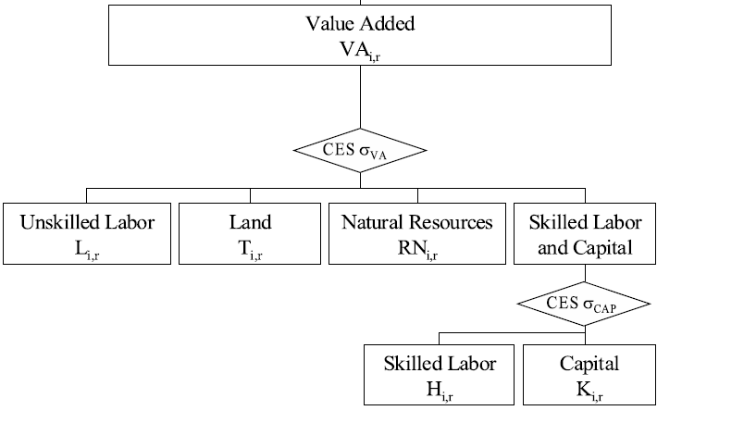
Land use representation in GTAP
CGE GTAP-like
production function
Value added is decomposed into labor and capital
Capital payments are decomposed into natural resources payments, land rents and capital payments
Volume of payments vary according to price fluctuations
Elasticities of land drive the representation of behavior:
- low elasticity = low reaction to prices
- high elasticity = neoclassical behavior of an efficient land use market
Linkage with physical hectares of land

Slide 9
Using data on land heterogeneity
The SAGE database has been adapted by Ramankutty and Seth for working in GTAP framework
Cropland is classified by 175 crops * 18 AEZ for 226 countries
  →Provides land rents at the GTAP level for 18 AEZ zones by country
Agro-Environmental Zone (AEZ) characterised by:
  6 Lengths of cultivation period: 0-60 days/60-120 days/ 120-180 days/… etc (related to humidity and precipitation regime)
  3 Climatic zones: Boreal/Temperate/Tropical
Allows to distinguish between specificities of each cultivation zone within a country
  Substitution mainly occurs within a zone
  Substitution from one zone to another is conditioned by the presence of crops on the two zone by indirect effect

Slide 10
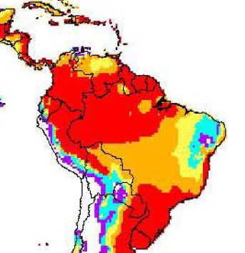
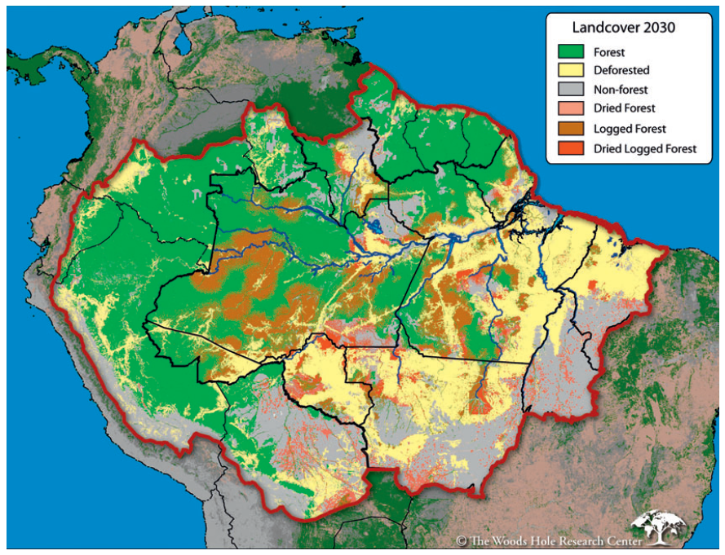
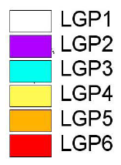
Correspondance between AEZ and local patterns: Brazil
AEZ zoning in 6 Lengths of Growing Period
Regional deforestation model
Source: Nepstad et al. (2006)
Source: Monfreda et al (2007)

Slide 11
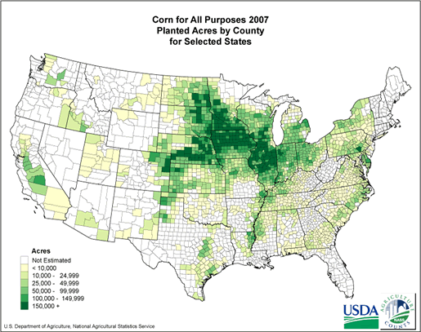
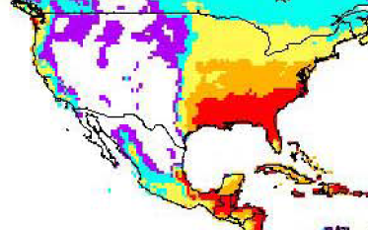
Correspondance between AEZ and local patterns: USA
AEZ zoning in 6 Length of Growing Periods
Corn cultivation in 2007
Source: Monfreda et al (2007)

Slide 12
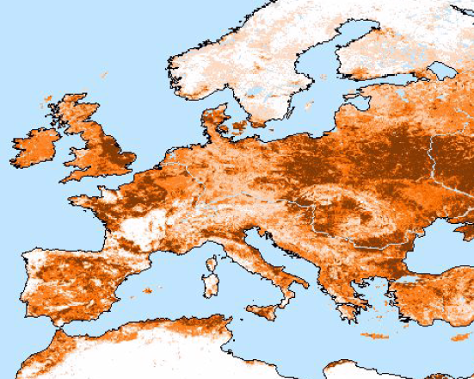
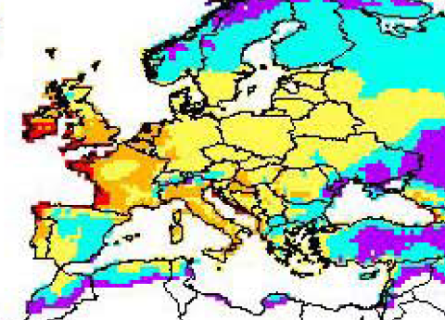
Correspondance between AEZ and local patterns: Europe
AEZ zoning in 6 Length of Growing Periods
Crop density in Europe in 1992
Source: Monfreda et al (2007)
Source: Ramankutty et al (2002)

Slide 13
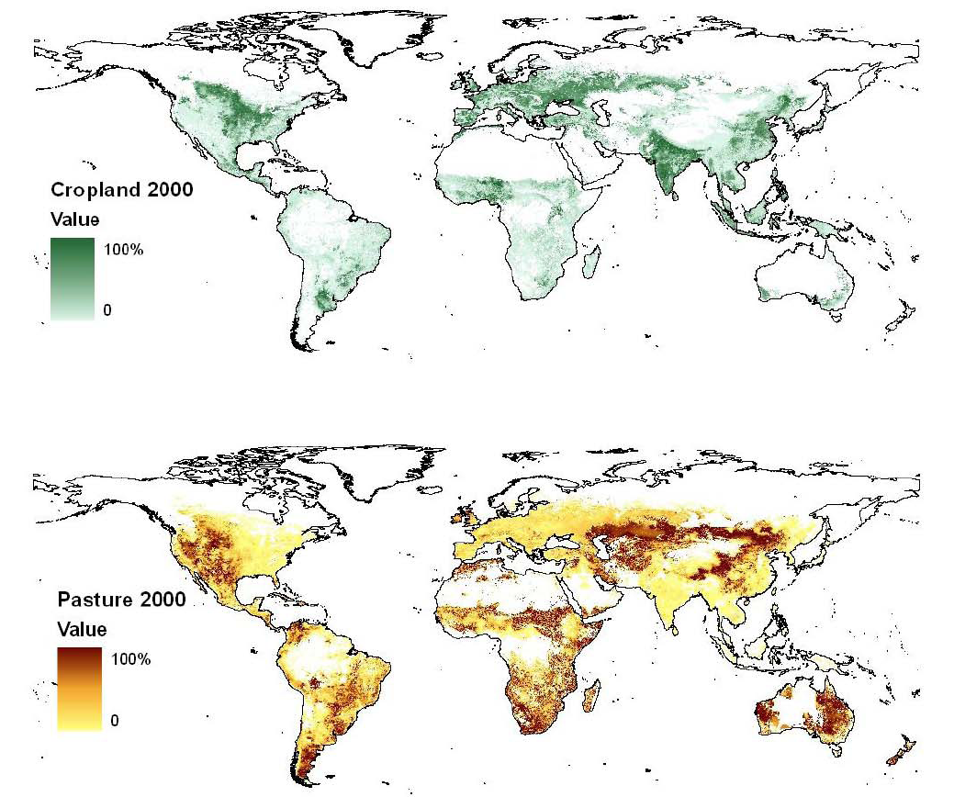
Complementarities between cropland and pasture: importance of AEZ
Source: Ramankutty et al. (2008)

Slide 14
Approach for land substitution for each AEZ
Wheat
Corn
Oilseeds
Approach chosen by many models:
OECD-PEM, GTAP, GOAL, LEITAP
4
CET
Sugar crops
Substitutable crops
Vegetables and fruits
Other crops
Livestock1
LivestockN
CET
CET
3
Cropland
Pasture
2
CET
Agricultural land
Managed forest
1
CET
Unmanaged land
Natural forest - Grasslands
Land extension
Managed land

Slide 15
CET and elasticities
Use of CET is one the most popular approach for this type of issue
Several designs have been tested (GTAP-BIO, OECD-PEM)
Nests and differentiated elasticities can represent:
  Regional specificities
  Crops substitution possibilities
Behavioral parameters can be derived from elasticities data from econometric studies
Land substitution elasticities used in literature
Model | Forest/ Crops | Pasture/ Crops | Crops/ Crops
GTAP-BIO model (Golub et al, 2007) | 0.25 | 0.5 | 1
GOAL model (Gohin, 2006) | 0.25 | 0.25 | 2
OECD-PEM model (OECD, 2003) | From 0.05 to 0.1 | From 0.1 to 0.2 | From 0.2 to 0.5
2 – Land substitution
Notes:
Although there are uncertainties associated with these estimates, it would be far less scientifically credible to ignore the effects of land use changes altogether than it is to use the best approach available to assess these known emissions sources.

Slide 16
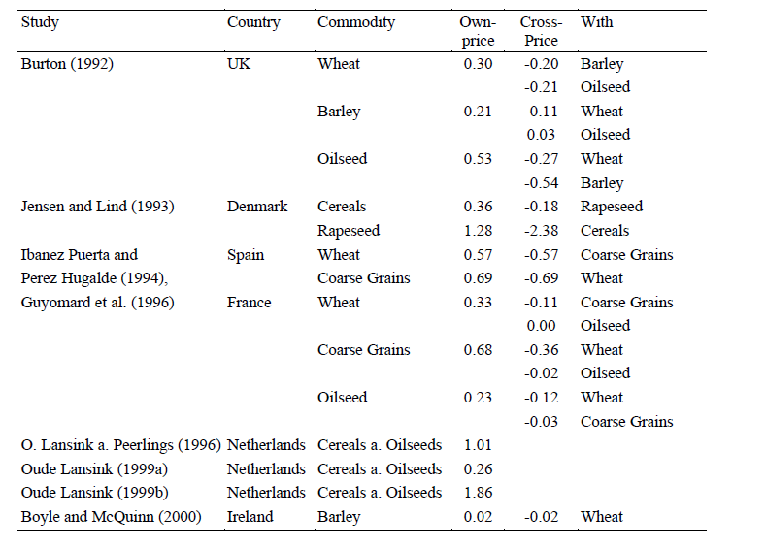
Variability among elasticity estimates: EU
2 – Land substitution
Source: Salhofer (2000)

Slide 17
Land elasticities chosen per region
 | σ_{TEZ} | σ_{TEZH} | σ_{TEZM} | σ_{TEZL} | Source
Oceania | 0.59 | 0.35 | 0.17 | 0.05 | OECD
China | 0.2 | 0.15 | 0.11 | 0.05 | Set similar to RoOECD (inc. Korea)
RoOECD | 0.2 | 0.15 | 0.11 | 0.05 | OECD (Japan)
RoAsia | 0.2 | 0.15 | 0.11 | 0.05 | Set similar to RoOECD (inc. Korea)
Indonesia | 0.59 | 0.30 | 0.11 | 0.1 | Set similar to Mexico
SouthAsia | 0.59 | 0.30 | 0.11 | 0.1 | Set similar to Mexico
Canada | 0.58 | 0.32 | 0.14 | 0.05 | OECD
USA | 0.55 | 0.32 | 0.15 | 0.1 | OECD
Mexico | 0.59 | 0.30 | 0.11 | 0.1 | OECD
EU27 | 0.23 | 0.22 | 0.21 | 0.05 | OECD (EU15)
LACExp | 0.59 | 0.30 | 0.11 | 0.1 | Set similar to Mexico
LACImp | 0.59 | 0.30 | 0.11 | 0.1 | Set similar to Mexico
Brazil | 0.59 | 0.30 | 0.11 | 0.1 | Set similar to Mexico
EEurCIS | 0.23 | 0.22 | 0.21 | 0.05 | Set similar to EU27
MENA | 0.35 | 0.24 | 0.15 | 0.05 | OECD (Turkey)
RoAfrica | 0.35 | 0.24 | 0.15 | 0.05 | Set similar to MENA
SAF | 0.35 | 0.24 | 0.15 | 0.05 | Set similar to MENA
2 – Land substitution

Slide 18
CARB LUC Results – Sugarcane Ethanol
Source: CARB, 2009
2 – Land substitution

Slide 19
Approach for land expansion
Land supply:
Several questions
  What is the land available?
  What is the associated productivity ?
  How much can land expand?
  Where do land expand ?
Land expansion of managed land:
  elasticity
  asymptotic position
  are the two important parameters
Marginal yield determines the land rent and production possibility increase
yield
Mean yield
Initial land
Maximum land
3 – Land expansion

Slide 20
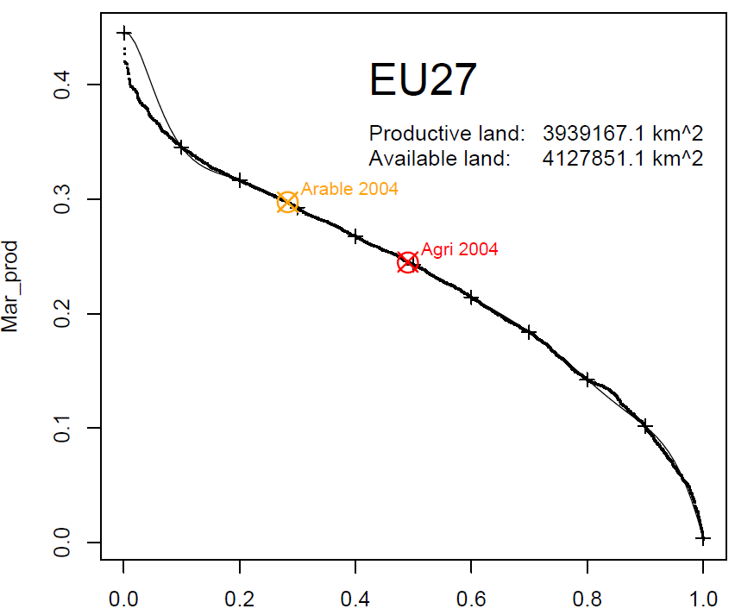
Marginal productivity
First solution:
External source (spatially explicit approach)
So far, potential for rainfed cultivation from IMAGE
But does not take into account the fact that some land is not accessible although productive
Second solution:
Corrected from direct calculations from production time series, average yield and land area ?
Source: IMAGE model, MNP acknowledged
3 – Land expansion

Slide 21
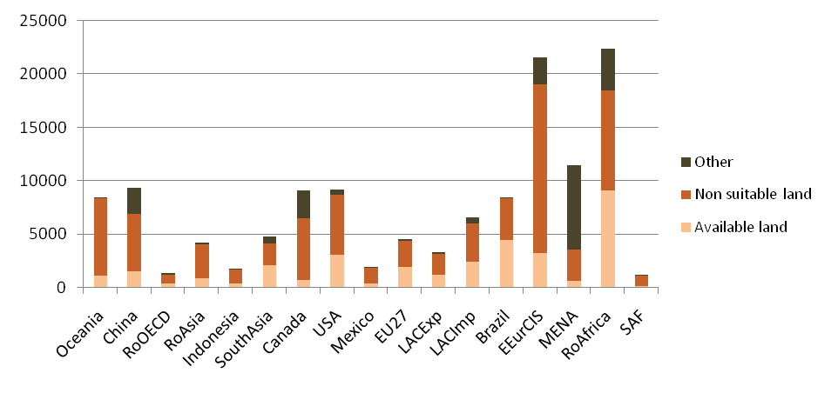
Data for available land
Based on IIASA data: several criteria.
We consider land very suitable + suitable + moderately suitable.
We consider land productive under mixed input level.
Mio ha
3 – Land expansion
Source: IIASA, AEZ database (2000)

Slide 22
Land available – High level of input
Source: IIASA, AEZ database (2000)
3 – Land expansion

Slide 23
Land available – Medium level of input
Source: IIASA, AEZ database (2000)
3 – Land expansion

Slide 24
Land available – Low level of input
Source: IIASA, AEZ database (2000)
3 – Land expansion

Slide 25
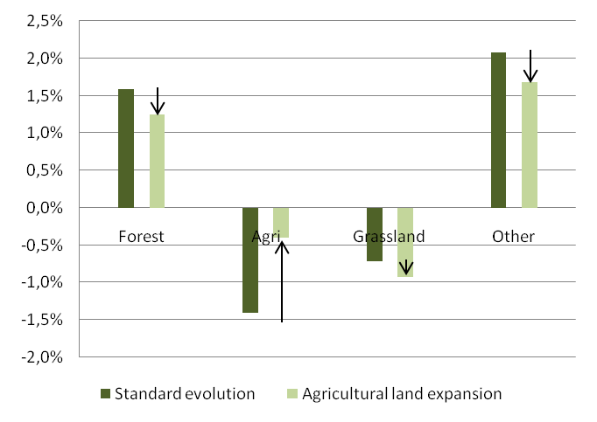
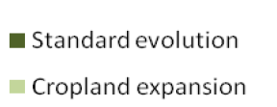
Managed land use expansion
Land use within managed land is endogenous
Unmanaged land
  Baseline is exogenous
  Land expansion marginal endogenous component: we distribute between unmanaged land following historical land use change
  Conversion source is allocated proportionnaly to past conversion intensity of different land use.
Cropland expansion comes from:
  Substitution between economic uses
  Expansion from grassland, primary forest and other land
4 – Allocation within unmanaged land

Slide 26
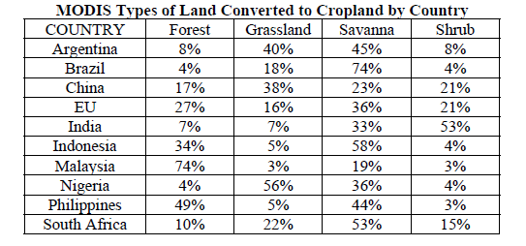
Historical land use
Based on FAO estimates on the 5 or 10 last years
  How marginal ?
  How accurate are the data ?
  FAO has limited number of land use
Computing expansion at the national level or at the national * AEZ level ?
  > need of historical changes at this level to be really effective
Approach chosen by EPA:
  building a precise historical database
  Relying on remote-sensing data
4 – Allocation within unmanaged land

Slide 27
Yield representation
Production structure tree
An exogenous technology component
An endogenous factor distribution effect
Calibration on elasticities of yield to fertiliser prices (provided by IFPRI partial equilibrium models)
Still research topic
Crop production
2
+TFP
Land and fertilisers
H L K E
1
H K E
Unskilled Labour (L)
Land
Ferti-lisers
Skilled labour (H)
Capital (K) + Energy (E)

Slide 28
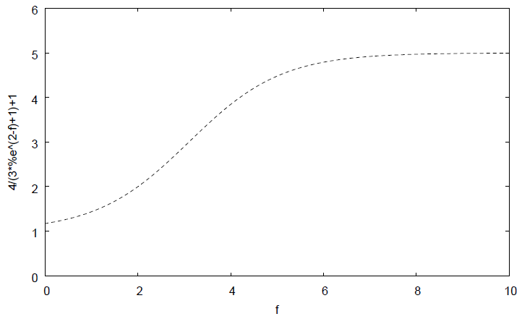
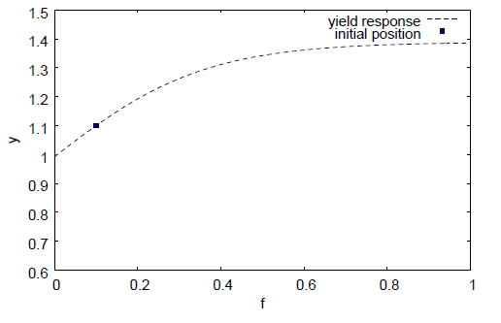
Calibrating yield behaviour
Idea: modelling input/land optimisation under a physical response? Difficult calibration
At the moment, more ad hoc approach with an isoelastic reaction to prices under physical constraint
Three parameters for the physical function:
  response of yield to fertiliser at the initial point (a)
  level of saturation (b)
  response of fertiliser consumption to price
(a)
(b)

Slide 29
4. Quelques exemples de résultats

Slide 30
Impact of a few biofuel policies
Scenario presented
  EU + US Ethanol mandate
  EU + US Ethanol mandate + liberalisation
EU: 10% mandate with 4% ethanol in 2020
US: 36 bn gallon by 2022 decreased to 30 bn gallon
Modelling of oilseeds market is delicate

Slide 31
Our baseline
18 regions and 35 sectors
Assumptions are important for:
  Oil prices (demand for biofuel)
    $65 in 2020 (IEA 2007)
    $110 in 2020 (IEA 2008)
  Evolution of crop production (productivity and cropland expansion)
    Productivity increase (technology component): +0.5/+1% per year
    Higher productivity for cattle and animals in developing countries
  Exogenous land use change: FAO 5 year variation extrapolated
  Crop prices (demand for new crops)
    highly dependant on regions and elasticitiy of substitution between fossil fuel and biofuel:
      Wheat: +38% in 2020
      Maize: +23% in 2020
      Oilseeds: +42% in 2020
      Sugar crops: +16% in 2020
  Biofuel production level:
    38 Mtoe in 2007, 64 Mtoe in 2020 (biodiesel)

Slide 32
Impact of an EU mandate
Production
Imports
 |  | 2020 | 2020 | 2020 | 2020 | 2020
Mtoe |  | Ref | DM | DM | FTM | FTM
 |  | Lev | Lev | Var | Lev | Var
Ethanol | USA | 14.24 | 33.52 | 135.5% | 31.13 | 118.6%
Ethanol | EU27 | 1.19 | 10.38 | 770.7% | 3.76 | 215.6%
Ethanol | Brazil | 17.68 | 27.20 | 53.9% | 39.78 | 125.0%
Biodiesel | USA | 0.92 | 0.86 | -6.8% | 0.99 | 7.4%
Biodiesel | EU27 | 16.23 | 15.96 | -1.7% | 16.01 | -1.4%

Slide 33
Feedstock production
 |  | 2020 | 2020 | 2020 | 2020 | 2020
 |  | Ref | DM | DM | FTM | FTM
 |  | Lev | Lev | Var | Lev | Var
Wheat | SouthAsia | 44218 | 44389 | 0.4% | 44306 | 0.2%
Wheat | EU27 | 30122 | 30885 | 2.5% | 30357 | 0.8%
Wheat | MENA | 18090 | 18400 | 1.7% | 18230 | 0.8%
Wheat | China | 17331 | 17464 | 0.8% | 17404 | 0.4%
Maize | USA | 29940 | 36313 | 21.3% | 35091 | 17.2%
Maize | China | 19695 | 19679 | -0.1% | 19683 | -0.1%
Maize | RoAfrica | 15595 | 15588 | 0.0% | 15590 | 0.0%
Maize | EU27 | 14612 | 15304 | 4.7% | 14821 | 1.4%
Maize | Mexico | 11840 | 12151 | 2.6% | 12112 | 2.3%
Sugar crops | SouthAsia | 21841 | 21970 | 0.6% | 22000 | 0.7%
Sugar crops | EU27 | 9710 | 11505 | 18.5% | 10243 | 5.5%
Sugar crops | Brazil | 7710 | 9370 | 21.5% | 11779 | 52.8%
Sugar crops | LACImp | 5966 | 7799 | 30.7% | 6893 | 15.5%

Slide 34
Feedstocks markets
 |  |  | 2020 | 2020 | 2020 | 2020 | 2020
 |  |  | Ref | DM | DM | FTM | FTM
 |  |  | Lev | Lev | Var | Lev | Var
Wheat | EEurCIS | EU27 | 223 | 326 | 46.4% | 245 | 10.1%
Wheat | Canada | USA | 120 | 121 | 0.9% | 121 | 0.8%
Wheat | Canada | EU27 | 105 | 142 | 34.5% | 109 | 3.4%
Wheat | Brazil | EU27 | 87 | 118 | 36.1% | 88 | 2.0%
Wheat | MENA | EU27 | 64 | 91 | 43.7% | 69 | 8.5%
Maize | Brazil | EU27 | 287 | 333 | 16.0% | 286 | -0.4%
Maize | Canada | USA | 222 | 338 | 52.4% | 313 | 41.4%
Maize | LACExp | EU27 | 196 | 222 | 13.6% | 196 | 0.3%
Maize | USA | EU27 | 120 | 83 | -30.8% | 81 | -32.6%
Maize | LACImp | USA | 113 | 235 | 107.6% | 207 | 82.4%
Maize | EEurCIS | EU27 | 82 | 99 | 20.9% | 86 | 6.1%
Maize | LACImp | EU27 | 69 | 80 | 15.5% | 71 | 2.3%
Maize | RoOECD | EU27 | 47 | 51 | 8.8% | 46 | -2.8%
OthCrop | LACImp | USA | 5013 | 5059 | 0.9% | 5095 | 1.6%
OthCrop | RoAfrica | EU27 | 4558 | 4674 | 2.5% | 4628 | 1.5%
OthCrop | LACImp | EU27 | 2723 | 2679 | -1.6% | 2696 | -1.0%
OthCrop | Brazil | EU27 | 2552 | 2517 | -1.4% | 2392 | -6.3%
OthCrop | EU27 | USA | 1262 | 1292 | 2.3% | 1299 | 2.9%
OthCrop | Brazil | USA | 1059 | 1065 | 0.6% | 1014 | -4.2%
VegFruits | LACImp | EU27 | 4504 | 4441 | -1.4% | 4464 | -0.9%
VegFruits | USA | EU27 | 3579 | 3572 | -0.2% | 3562 | -0.5%
VegFruits | Mexico | USA | 3348 | 3356 | 0.2% | 3350 | 0.1%
VegFruits | LACImp | USA | 2645 | 2629 | -0.6% | 2644 | 0.0%
VegFruits | MENA | EU27 | 2526 | 2571 | 1.8% | 2557 | 1.2%
VegFruits | RoOECD | EU27 | 2171 | 2192 | 1.0% | 2182 | 0.5%
OilseedBio | Brazil | EU27 | 11480 | 11527 | 0.4% | 11338 | -1.2%
OilseedBio | USA | EU27 | 3210 | 2910 | -9.3% | 2956 | -7.9%
OilseedBio | LACExp | EU27 | 2488 | 2508 | 0.8% | 2503 | 0.6%
OilseedBio | EEurCIS | EU27 | 527 | 545 | 3.4% | 544 | 3.1%
OilseedBio | Canada | EU27 | 475 | 465 | -2.2% | 468 | -1.7%
OilseedBio | Canada | USA | 251 | 253 | 1.2% | 255 | 1.6%
OilseedBio | RoOECD | EU27 | 164 | 163 | -0.1% | 163 | 0.0%
OilseedBio | Brazil | USA | 154 | 163 | 5.8% | 160 | 3.7%

Slide 35
Feedstocks markets
 |  |  | 2020 | 2020 | 2020 | 2020 | 2020
Mio USD | From | To | Ref | DM | DM | FTM | FTM
 |  |  | Lev | Lev | Var | Lev | Var
Wheat | EEurCIS | EU27 | 223 | 326 | 46.4% | 245 | 10.1%
Wheat | Canada | USA | 120 | 121 | 0.9% | 121 | 0.8%
Wheat | Canada | EU27 | 105 | 142 | 34.5% | 109 | 3.4%
Wheat | Brazil | EU27 | 87 | 118 | 36.1% | 88 | 2.0%
Wheat | MENA | EU27 | 64 | 91 | 43.7% | 69 | 8.5%
Maize | Brazil | EU27 | 287 | 333 | 16.0% | 286 | -0.4%
Maize | Canada | USA | 222 | 338 | 52.4% | 313 | 41.4%
Maize | LACExp | EU27 | 196 | 222 | 13.6% | 196 | 0.3%
Maize | USA | EU27 | 120 | 83 | -30.8% | 81 | -32.6%
Maize | LACImp | USA | 113 | 235 | 107.6% | 207 | 82.4%
Maize | EEurCIS | EU27 | 82 | 99 | 20.9% | 86 | 6.1%
Maize | LACImp | EU27 | 69 | 80 | 15.5% | 71 | 2.3%
Maize | RoOECD | EU27 | 47 | 51 | 8.8% | 46 | -2.8%
OthCrop | LACImp | USA | 5013 | 5059 | 0.9% | 5095 | 1.6%
OthCrop | RoAfrica | EU27 | 4558 | 4674 | 2.5% | 4628 | 1.5%
OthCrop | LACImp | EU27 | 2723 | 2679 | -1.6% | 2696 | -1.0%
OthCrop | Brazil | EU27 | 2552 | 2517 | -1.4% | 2392 | -6.3%
OthCrop | EU27 | USA | 1262 | 1292 | 2.3% | 1299 | 2.9%
OthCrop | Brazil | USA | 1059 | 1065 | 0.6% | 1014 | -4.2%

Slide 36
Economic impact

Slide 37
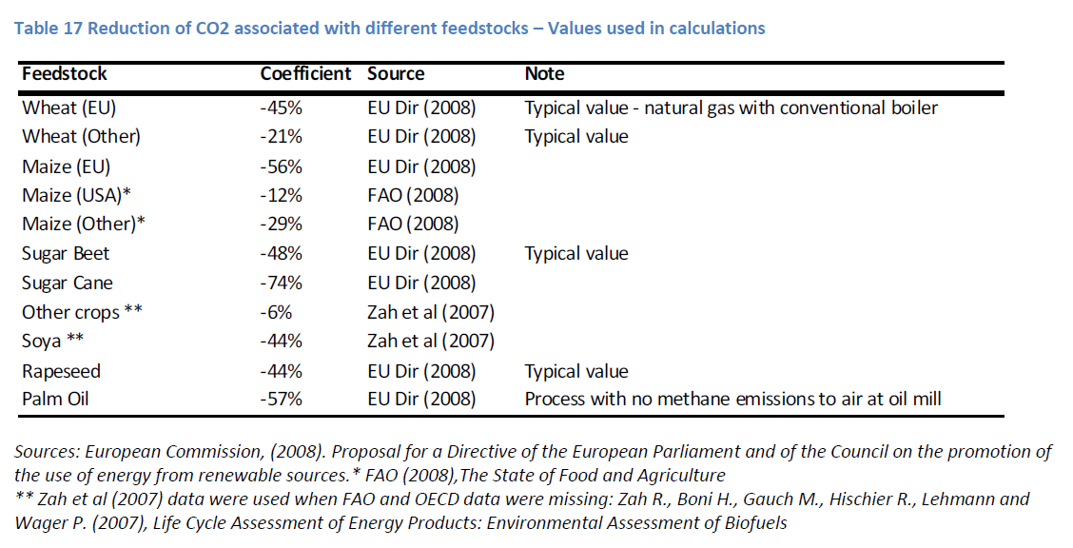
Quantifying biofuel direct effects

Slide 38
Carbon savings (Mtoe)
 |  | 2020 | 2020 | 2020 | 2020
 |  | DM | DM | FTM | FTM
 |  | Lev | Share | Lev | Share
World | Ethanol - Wheat | -3,742,146 | 8.6% | -918,674 | 1.8%
World | Ethanol - Maize | -7,222,083 | 16.5% | -5,507,679 | 10.9%
World | Ethanol - Sugar Beet | -5,403,728 | 12.4% | -1,573,108 | 3.1%
World | Ethanol - Sugar Cane | -27,255,603 | 62.4% | -42,292,511 | 83.9%
World | Ethanol - Other Crops | -57,940 | 0.1% | -123,253 | 0.2%
World | Ethanol - All crops | -43,681,500 | 100.0% | -50,415,226 | 100.0%

Slide 39
Global land use effect
 |  | 2020 | 2020 | 2020 | 2020 | 2020
 |  | Ref | DM | DM | FTM | FTM
 |  | Lev | Lev | Var | Lev | Var
Pasture | EU27 | 0.71 | 0.70 | -0.45% | 0.71 | -0.13%
Cropland | EU27 | 1.17 | 1.18 | 0.53% | 1.17 | 0.20%
Other | EU27 | 1.17 | 1.17 | -0.17% | 1.17 | -0.07%
Forest_managed | EU27 | 1.47 | 1.47 | -0.07% | 1.47 | -0.04%
Forest_primary | EU27 | 0.07 | 0.07 |  | 0.07
Forest_total | EU27 | 1.55 | 1.54 | -0.07% | 1.55 | -0.04%
Total exploited land | EU27 | 3.35 | 3.35 | 0.06% | 3.35 | 0.02%
Pasture | USA | 2.39 | 2.38 | -0.60% | 2.38 | -0.47%
Cropland | USA | 1.92 | 1.94 | 0.96% | 1.94 | 0.76%
Other | USA | 1.88 | 1.88 | -0.14% | 1.88 | -0.11%
Forest_managed | USA | 2.97 | 2.97 | -0.05% | 2.97 | -0.04%
Forest_total | USA | 2.97 | 2.97 | -0.05% | 2.97 | -0.04%
Total exploited land | USA | 7.28 | 7.28 | 0.03% | 7.28 | 0.03%
Pasture | Brazil | 1.94 | 1.94 | -0.09% | 1.93 | -0.18%
Cropland | Brazil | 0.84 | 0.85 | 0.80% | 0.85 | 1.63%
Other | Brazil | 1.43 | 1.43 | -0.15% | 1.43 | -0.30%
Forest_managed | Brazil | 0.19 | 0.19 | -0.18% | 0.19 | -0.52%
Forest_primary | Brazil | 4.11 | 4.11 | -0.06% | 4.11 | -0.12%
Forest_total | Brazil | 4.30 | 4.30 | -0.07% | 4.29 | -0.14%
Total exploited land | Brazil | 2.97 | 2.97 | 0.16% | 2.98 | 0.31%

Slide 40
Quantifying biofuel indirect effects
Land use indirect effects
  Emissions from deforestation
    Based on IPCC values
    Natural forest vs plantation
    Distinction per AEZ
    Integration of below ground values
  Emissions from mineral carbon in soil
    Release due to land use (IPCC values)
    Agricultural use on new land generates emissions
Other indirect effect: related to price of energy and crops for other sectors

Slide 41
Indirect land use emissions
 | Deforestation emissions |  | New land cultivation emissions
 | 2020 | 2020 | 2020 | 2020
 | DM | FTM | DM | FTM
Oceania | 220,187 | 147,552 | 325,594 | 234,395
China | 172,903 | 61,826 | 192,276 | 139,459
RoOECD | 339,948 | 238,736 | 218,874 | 155,093
RoAsia | 198,612 | 166,806 | 134,936 | 117,737
Indonesia | 372,087 | 321,848 | 100,193 | 87,928
SouthAsia | 38,772 | 33,821 | 62,350 | 32,461
Canada | 624,051 | 452,104 | 705,587 | 523,202
USA | 1,979,867 | 1,583,728 | 6,714,303 | 5,309,671
Mexico | 801,583 | 649,672 | 241,330 | 199,499
EU27 | 1,465,003 | 873,425 | 2,843,712 | 1,072,558
LACExp | 580,587 | 554,376 | 715,341 | 559,374
LACImp | 3,803,826 | 2,332,519 | 1,375,410 | 814,762
Brazil | 12,391,466 | 25,150,376 | 3,364,535 | 6,783,709
EEurCIS | -286,555 | -165,088 | 1,888,693 | 1,340,669
MENA | -184,069 | -100,173 | 292,257 | 191,597
RoAfrica | 4,145,415 | 3,362,179 | 908,297 | 730,871
SAF | -28,701 | -74,165 | 234,462 | 580,962
World | 26,634,983 | 35,589,543 | 20,318,150 | 18,873,946

Slide 42
Total environmental effect
The indirect effect induced by first generation biofuel could degrade significantly their benefits.

Slide 43
Data issues and critical parameters
Issue of the link between SAMS data on land use and real land use data
Elasticities are the most critical parameters and especially sensitive for the results
  Biofuel vs Fuel: has important implications on subsidy effects and incentive due to high oil prices. Hard to evaluate because of the role of policy effect against market effect.
  Land substitution elasticities: studies made for OECD PEM illustrate the degree of uncertainty.
  Land expansion: very debated link: the progress of research must concentrate here
  Land yield elasticities
  Role of Armington: more effect on domestic markets
Non market effects play important role
Carbon debt (years in 2020) | DM | FTM
F+ (fertilisers x4) | 8.4 | 10.3
F- (fertilisers /4) | 17.6 | 21.7
L+ (x4 in South, x2 in North) | 31.8 | 32.5
L- (/4 in South, /2 in North) | 4.4 | 2.7

Slide 44
5. Evolutions et perspectives

Slide 45
Evolutions et perspectives
Développements nouveau en cours:
  Données
    Huiles végétales détaillées
    DDGS
    Tourteaux d’oléagineux
  Modélisation
    Reflexion sur le lien livestock / land use
    Simplification des hypothèses pour analyse de sensibilité massive

Slide 46
Initiatives dans le cadre de la directive européenne sur l’usage des énergies renouvelables dans les transports
Policy: Commission européenne:
  DG Trade: Commande de résultats pour fin septembre/début octobre: effets marginaux des ILUC et politique commerciale
  Initiative conjointe du JRC et de l’OCDE pour faire une comparaison des modèles et de leurs résultats
Recherche:
  FP7 AgFoodTrade
  poursuite des travaux dans le cadre IFPRI (impacts et opportunités PVD)

Slide 47
Conclusions
Un problématique complexe qui se heurte aux limites actuelles du savoir et des outils
Une forte demande des décideurs face à la pression des acteurs et au manque d’information
Un décalage de temporalité délicat à gérer face à l’agenda politique
Le contexte des négociations climatiques rajoutent un besoin d’expertise
Des pistes de recherche nombreuses promettant encore des années de mobilisation

